Slide 1
JSON
( the argonauts and mark )
INTERACTIVE 3D VERSION WITH FRILLY BITS AND SOURCE
http://r1.my/klmug/11/
WARNING :: Some Assembly Required
PRESENTED BY - @m_smalley

Slide 2

NOT THIS JASON
Notes:
2

Slide 3
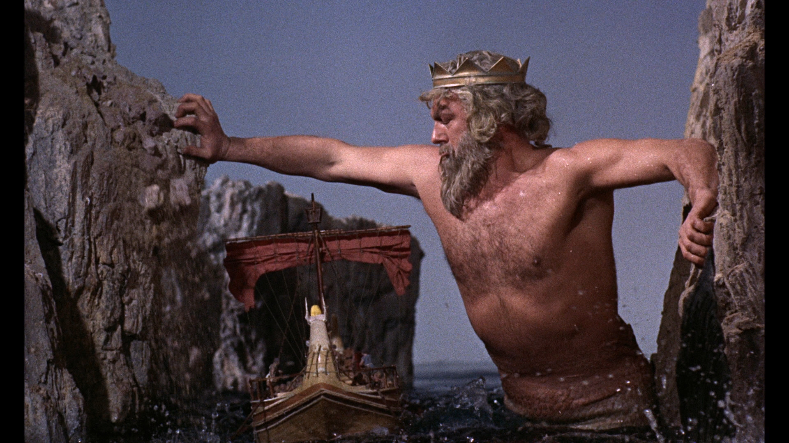
NOR THESE ARGONAUTS
IS THAT SQL I SMELL?
Notes:
3

Slide 4



RATHER THESE
Notes:
4

Slide 5

A LONG TIME AGO, IN A GALAXY FAR, FAR AWAY
1992 = Windows 3
and Microsoft Basic
1994
16th Birthday:
Leave Tatooine
Notes:
5

Slide 6
1998
-- Flash was The Dog’s Bollocks --
AND I HAD FOUND MYSELF IN SARAWAK

Slide 7

2006 – STARTED A WEB DESIGN AGENCY IN KL
Notes:
7

Slide 8
2010
-- CASHED-OUT --
WANTING TO DO MORE THAN JUST WORDPRESS THEMES

Slide 9
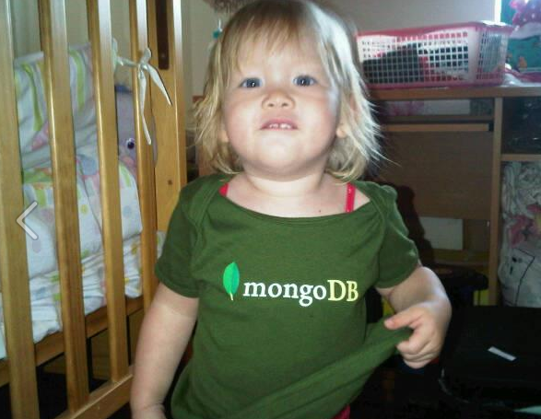
GOT MARRIED, HAD A KID – GREW A FAMILY
Notes:
9

Slide 10
2011
-- MongoDB :: Day 01 --
LAZY WINDOWS WEB-DESIGNER WITH NO KNOWLEDGE OF TERMINAL

Slide 11
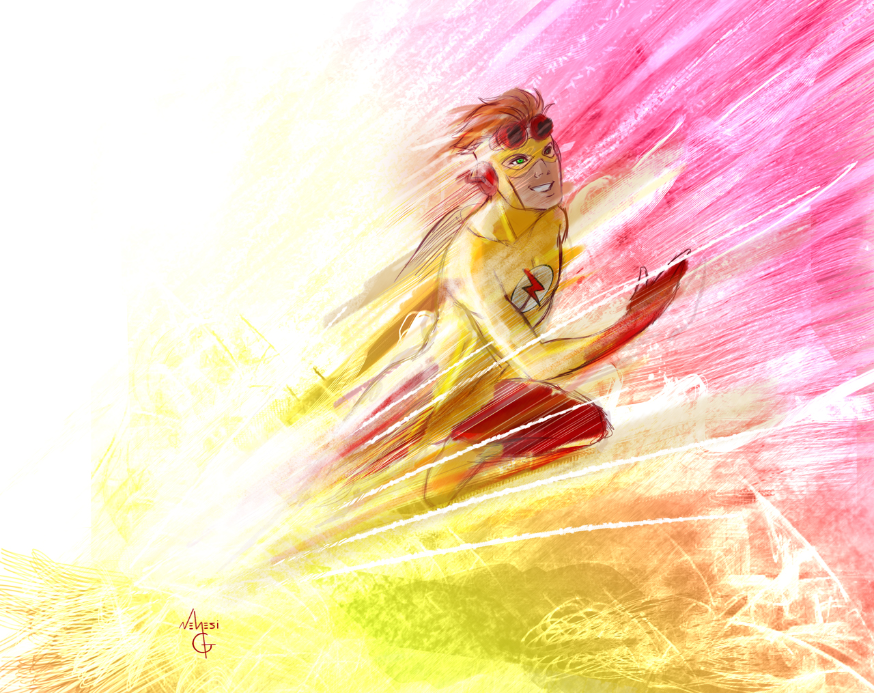
IT’S LIGHTENING FAST !!!
Some say 6,000 times faster than MySQL
Notes:
11

Slide 12
2011
-- MongoDB :: Day 02 --
DISGRUNTLED BACKPRESS USER

Slide 13
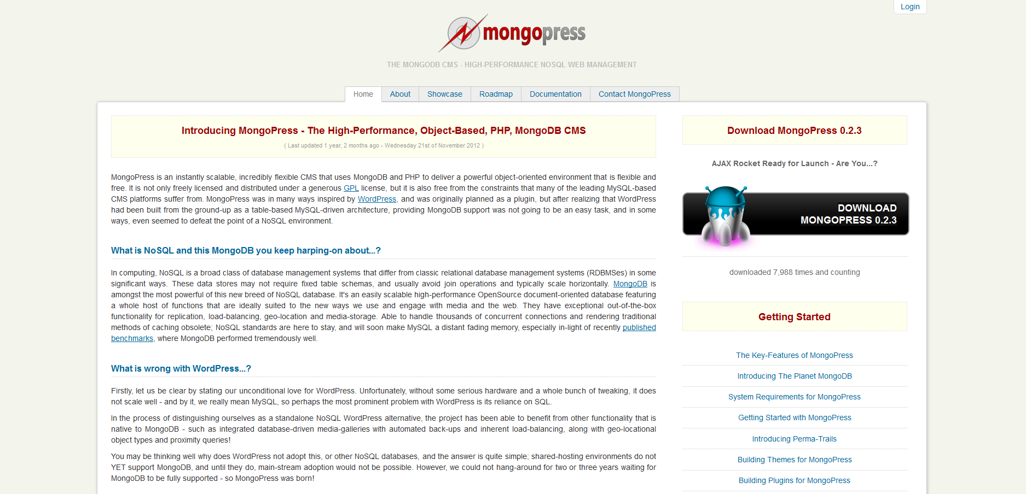
MongoPress 0.2 :: (Before Bootstrap)
Notes:
13

Slide 14
2011
-- MongoDB :: Day 367 (ish) --
NO UPDATES IN A YEAR

Slide 15

MongoPress 0.3 :: (Bootstrap + MongoBase)
Notes:
15

Slide 16

2012 – Self Discovery :: R1 :: Foundations
.org
Notes:
16

Slide 17
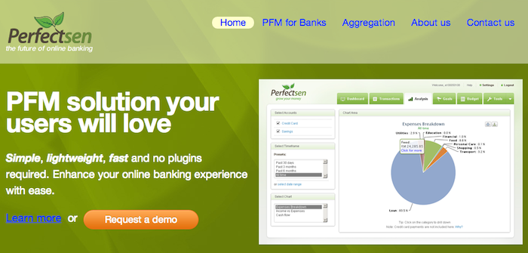
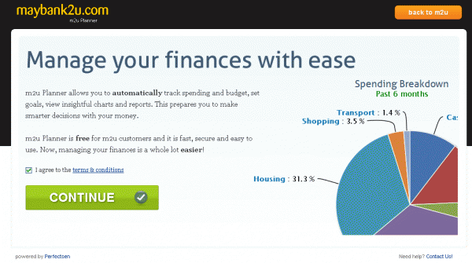
YESTERDAY – CTO at Perfectsen
White-Label PFM
Largest Bank in Malaysia
Notes:
17

Slide 18
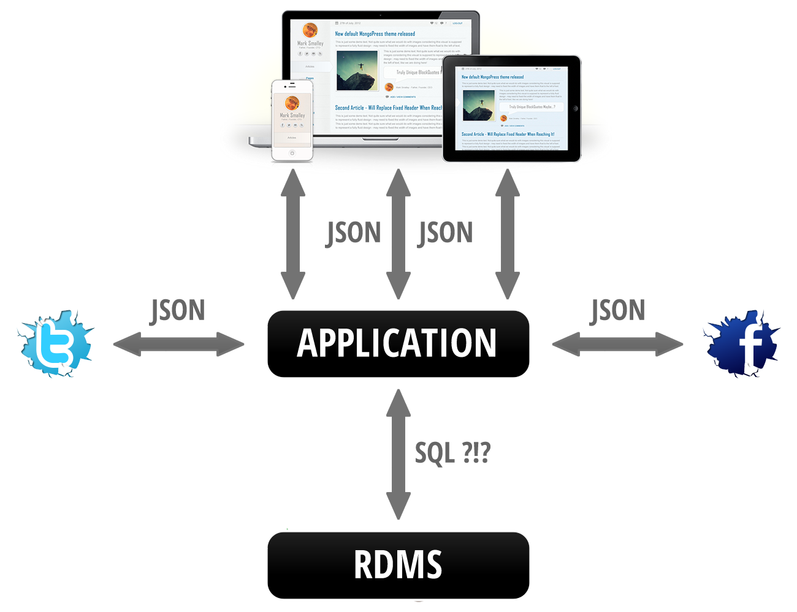
LOTS OF JSON
Notes:
18

Slide 19
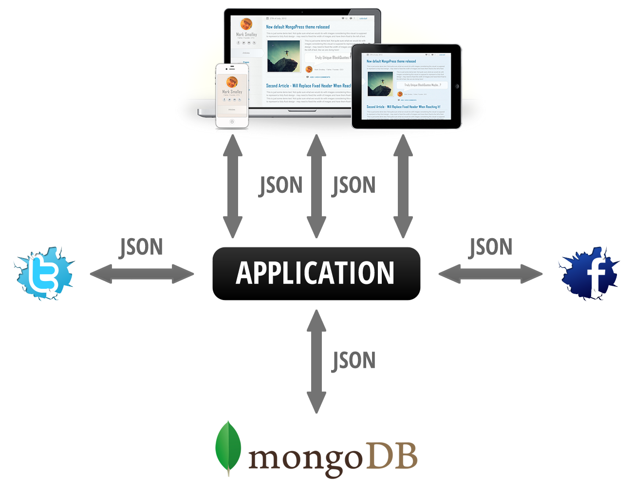
LOTS OF JSON
Notes:
19

Slide 20
IMPORTANT DATES
1974
RELATIONAL DATABASES
1989
WORLD WIDE WEB
Notes:
20

Slide 21
IMPORTANT DATES
2002
JSON.org
2009
MongoDB.org
Notes:
21

Slide 22
THE BIG THREE ONs
JSON ( j for javascript )
JSONP ( p for padding )
BSON ( b for binary )
Notes:
22

Slide 23
THE BIG THREE ONs
JSON ( j for javascript )
JSONP ( p for padding )
BSON ( b for binary )
Supported by jQuery / PHP
Notes:
23

Slide 24
THE BIG THREE ONs
JSON ( j for javascript )
JSONP ( p for padding )
BSON ( b for binary )
Supported by jQuery / PHP
Built for MongoDB
Notes:
24

Slide 25
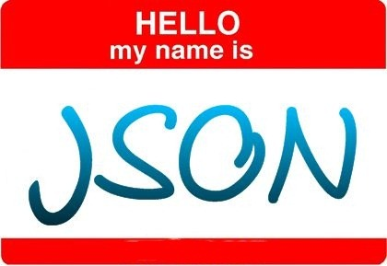
[
title: “Hello JSON World”,
published: 1352229385,
slug: “hello-world”,
content: “<p>JSON has 6 data-types</p>”,
tags: [“categories”,”test”,”etc”],
comments: [
{ u: ”Jason”, c: “Thanks for sharing” }
]
]
Notes:
25

Slide 26
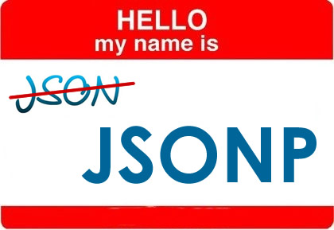
callback_function([
title: “Hello JSONP World”,
published: 1352229385,
slug: “hello-world”,
content: “<p>JSONP is padded with a function</p>”,
tags: [“categories”,”test”,”etc”],
comments: [
{ u: ”Jason”, c: “Thanks for sharing” }
]
])
Notes:
26

Slide 27
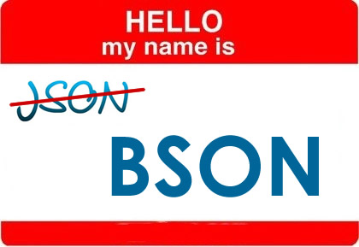
[
“_id”: ObjectId(“50994e2e9bd64215053f7b22”),
“title”: “Hello BSON World”,
“published”: ISODate(“2008-02-03T00:00-00Z”),
“slug”: “hello-world”,
“content”: “<p>BSON has 11 data-types</p>”,
“tags”: [“categories”,”test”,”etc”],
“comments”: [
{ “u”: ”Jason”, “c”: “Including JS Code! :-)” }
]
]
Notes:
27

Slide 28
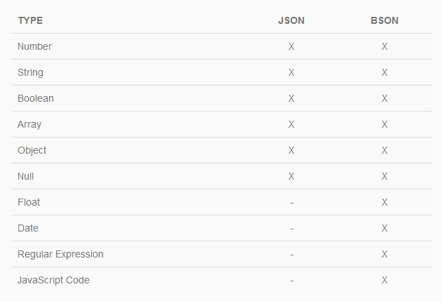
JSON Vs BSON
Notes:
28

Slide 29
THE TRUE ARGONAUTS
Notes:
29

Slide 30
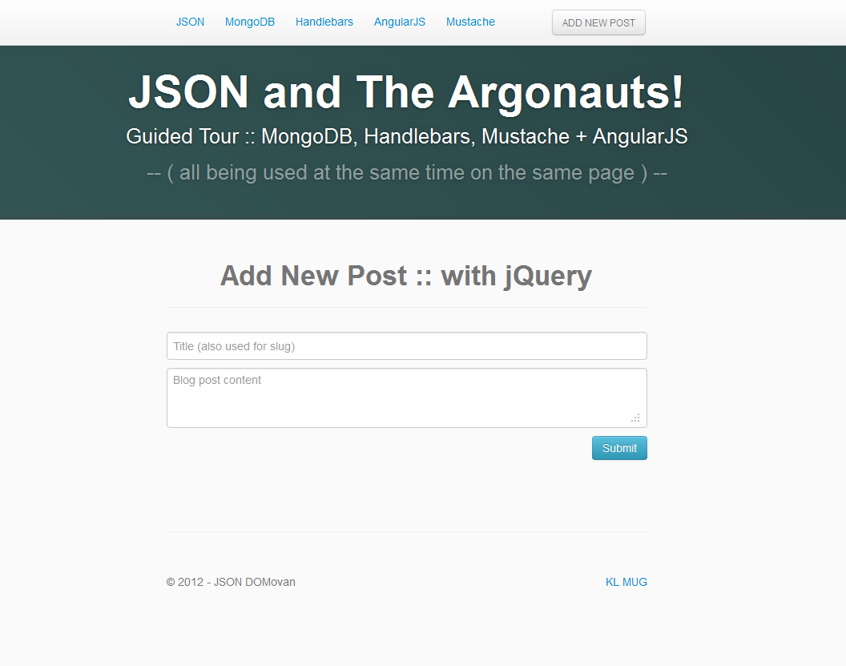
SOURCE CODE AVAILABLE – http://r1.my/klmug/11/
Notes:
30

Slide 31

LEARN MORE | SAY HELLO
http://mongodb.my | @m_smalley
Notes:
31

